Slide 1
LAB6 Digital I/O

Slide 2
What is “digital I/O”
It is an interface in which each electrical pin may have two states:
Logical 0 (0V)
Logical 1 (5V on the basis of the VDD)
Each line can be programmer as:
an output (lit a LED)
an input (read a pushbutton)

Slide 3
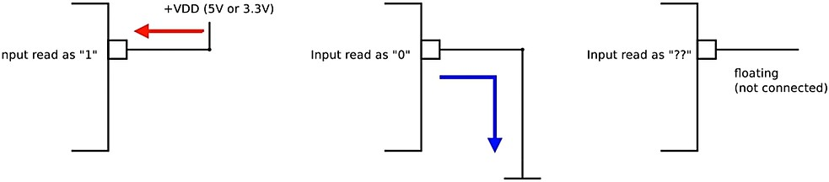
Digital Input: Electrical consideration
An input connected to VDD is read (by software) as “1”
An input connected to Ground is read (by software) as “0”
If the input is floating (not connected), the value read cannot be determined!
I

Slide 4
Prevent floating state
The typical pull-up resistor value is 1-10kΩ .
If in doubt, a good starting point when using a switch is 5kΩ.
Disadvantage
a larger resistance : the input pin responses to voltage changes slower
a smaller resistance : Too much current flow through

Slide 5
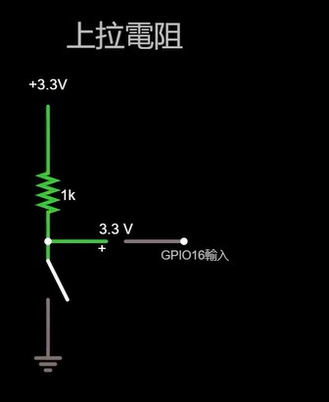
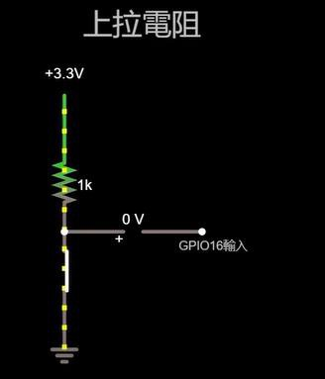
Prevent floating state
Use pull-up resistor
Switch open, the value read is “1”
Switch closed, the value read is “0”

Slide 6
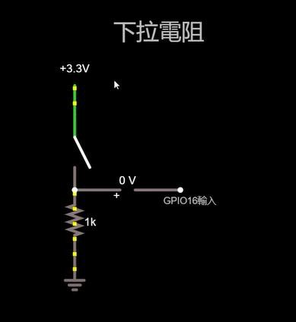
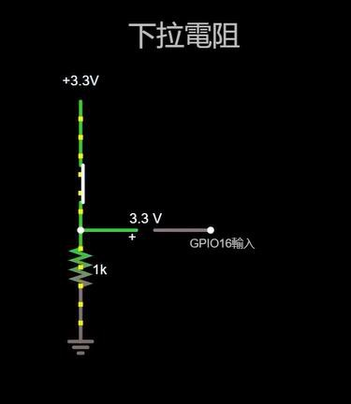
Prevent floating state
Use pull-down resistor
- Switch open, the value read is “0”
- Switch closed, the value read is “1”

Slide 7
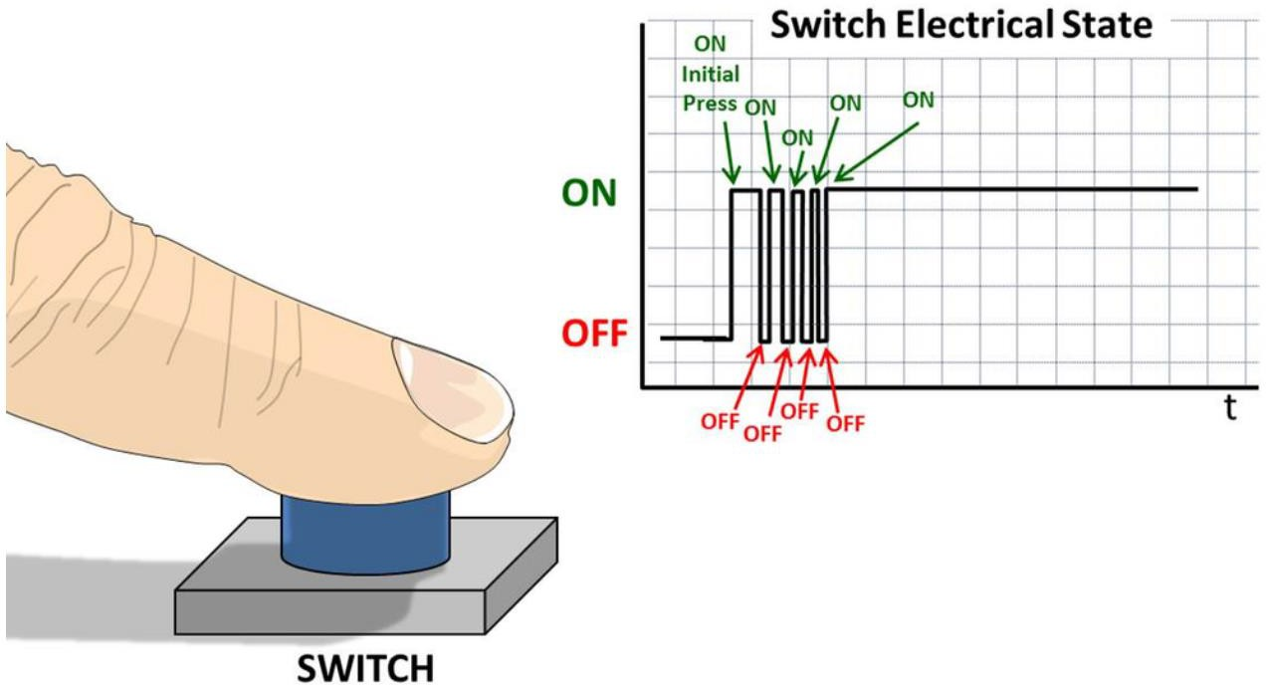
Bouncing problem!
Due to mechanical reasons, pushbuttons and switches(which have a spring inside)
typically generate a bouncing signal when pressed or released.
The bouncing signal is read by software ,thus causing malfunctioning.

Slide 8
Button debounce
Hardware solution
Add a capacitor, in parallel with the button, in order to filter the bouncing signal.
Reference: http://puppyodie.blogspot.com/2016/04/button-debounce.html
Software solution
Use delay or interrupt on change function to check input signal again, if the signal stay the same, then considered as press.

Slide 9
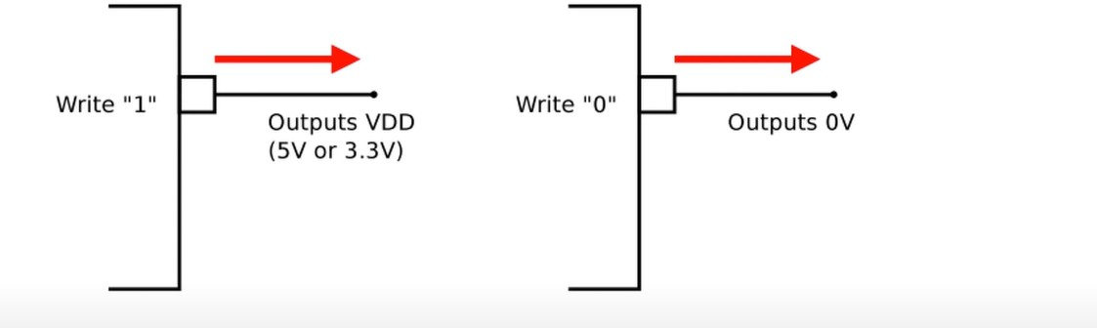
Digital Output Electrical consideration
Writing “1” : output high voltage(VDD)
Writing “0” : output low voltage(GND)

Slide 10
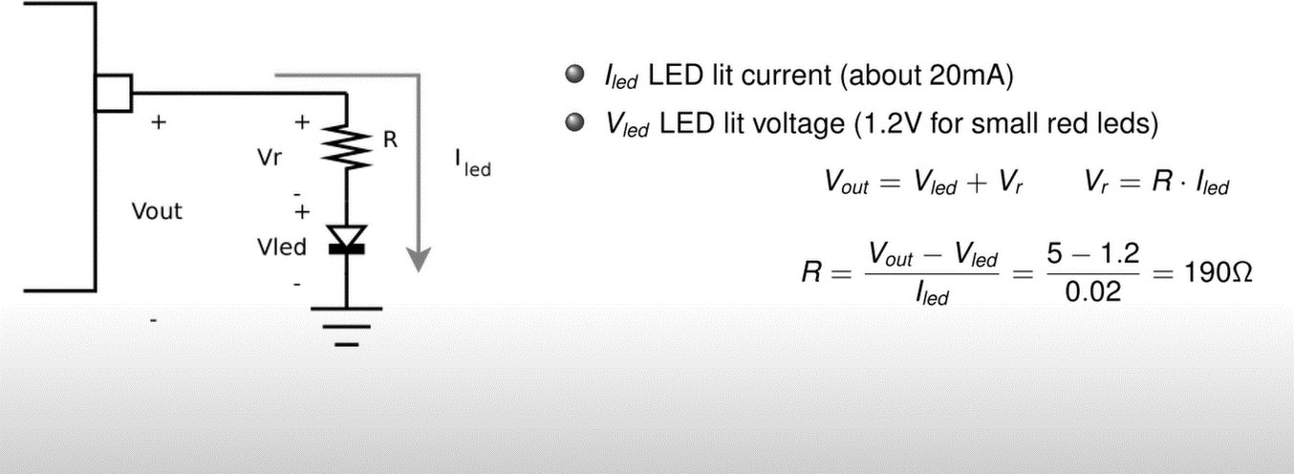
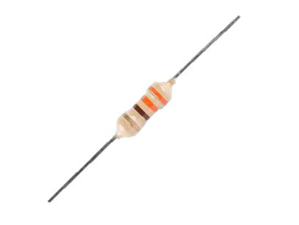
Connecting a LED: calculating the limiting resistor
330Ω

Slide 11
I/O ports of PIC18F4520

Slide 12
I/O ports of PIC18F4520
PIC18F4520 has five I/O ports, called PORTA, PORTB, …, PORTE.
Each port (A-D) has 8 bits and thus 8 electrical pins
Pins are referred as RXY, where X is the port name(A,B,…,E)and Y is the bit number (0, 1, …, 7)
- Ex: RA2→ bit 2 of PORTA
Some pins of the I/O ports are multiplexed with an alternate function from the peripheral features on the device. In general when a peripheral is enabled, that pins may not be used as a general purpose I/O pins.

Slide 13
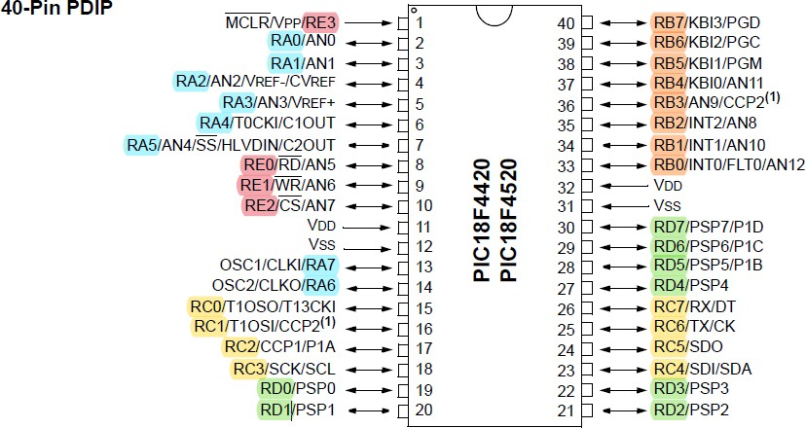
I/O ports of PIC18F4520

Slide 14
SFR of PIC18F4520 I/O ports
Each port has 3 registers for its operation. These registers are :
TRIS register - configure the port as Input or Output
PORT register - reads voltage of the device
LAT register - output voltage

Slide 15
SFR of PIC18F4520 I/O ports
TRISx: each bit of this SFR programs the relevant PIN as input or output:
0 means output
1 means input
Example:
TRISC = 0x30 ; // 0x30 = 0011 0000
RC0 to RC3 → outputs
RC4, RC5
RC6, RC7
→ inputs
→ outputs

Slide 16
SFR of PIC18F4520 I/O ports
LATx: each bit of this SFR programs the output status of the relevant PIN (if it is programmed as output, otherwise it is ignored).
Example:
LATB = 0xe0; // 0xe0 = 1110 0000
RB0 to RB4 output 0;
RB5 to RB7 output 1;

Slide 17
SFR of PIC18F4520 I/O ports
PORTx: each bit of this SFR reflects the input status of the relevant PIN (if the pin is configured as input, otherwise it replies as the bit of the LATx register
Example:
Let us read into button variable, the status of the RA5 input pin: int button = (PORTA & 0x20); // 0x20 = 0010 0000

Slide 18
Bit Field Manipulation

Slide 19
Bit Field Manipulation in assembly
Single bit manipulation
BCF f, b, a - clear bit b of register f
ex: BCF LATB, 0, 0 // will clear LATB bit 0
BSF f, b, a - set bit b of register f
ex: BSF TRISA, 5, 0 // will set TRISA bit 5
BTG f, b, a - toggle bit b of register f
ex: BTG LATC, 3, 0 // will toggle LATC bit 3

Slide 20
Bit Field Manipulation in assembly
Multiple bits manipulation
Clear bit: use ANDWF operation
Set bit: use IORWF operation
Toggle bit: use XORWF operation

Slide 21
Bit Field Manipulation in C
The processor-specific header file includes a structure definition that allows the user to access individual bits of a register.
Example
PORTBbits.RB0 = 1; // pull PORTB bit 0 to high
LATBbits.LATB0 = 0; // pull LATB bit 0 to low
TRISBbits.TRISB0 = 0; // pull TRISB bit 0 to low
STATUSbits.C = 0; // clear the C flag to 0

Slide 22
PIC18f4520

